Slide 1
CS218 - DATA STRUCTURES
PROJECT IDEAS
Presented by: Data Structures TA’s
Saad Ismail (k16-4060)
Mehdi Raza Rajani (k16-3904)
Hasan Gilani (k17-3648)

Slide 2
Project Must Contain
Data Structures (obviously)
Queue
Stack
Linked List
Tree (Binary Tree, Binary Search Tree, B Tree)
Graph
Set (Hash Set, Disjoint Set)
Map (Hash Map)
Any other advanced structure that you may need to use based on your project.
Note: Using C++ Primitive Array is not sufficient for the project.

Slide 3
Project Theme
Text Processing
What is Text Processing?
The Manipulation of Text
Especially the Transformation of Text from One Format to Another
Mainly Includes
Searching and Replacing
Formatting
Generating a Processed Report of the Content
Note: Text Processing is not Text Mining or Natural Language Processing. Working on Text Processing is enough for the project.

Slide 4

Let’s Begin with Amazing
Project Ideas

Slide 5
DNA Corpus Matching using Trie
Suffix Trie is a tree-based Data Structure commonly used for Pattern Matching
The Real Task:
Given a DNA string, find the matching corpus
DNA corpus and some test data will be provided
Group Size:
1 - 2 Students
Important Note:
Your solution will be tested on different data
Data will be provided

Slide 6
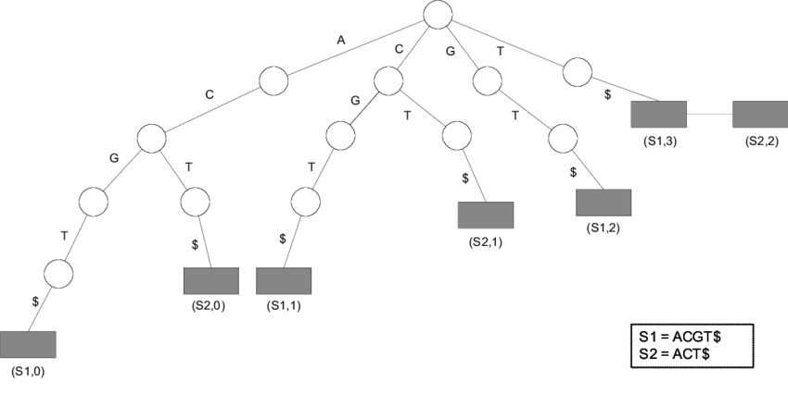
Trie - Source:
https://www.researchgate.net/publication/220195697_An_efficient_approach_for_sequence_matching_in_large_DNA_databases

Slide 7
Thai Language Tokenizer
No punctuations in Thai Language, spaces are added based on language rules. FSM is helpful in adding spaces.
The Real Task:
Implementation of FSM (Finite State Machine)
Group Size:
1 - 2 Students
Important Note:
Your solution will be tested on different data.

Slide 8
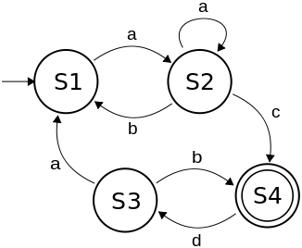
Finite State Machine - Source:
https://brilliant.org/wiki/finite-state-machines/

Slide 9
Extracting Trends from Citations Database
Data is available on https://dblp.uni-trier.de for citations database.
The Real Task:
Scraping and Parsing of data
Extracting useful trends (connectivity with co-authors) about given author
Group Size:
2 - 3 Students
Important Note:
Bonus Task: Refine the data by Venue and Type

Slide 10
Advance String Matching
Data Structure Proposed:
Find it by your own.
The Real Task:
Implement at least 2 Advance String Matching Algorithms.
Compare their efficiencies on Large Strings and different kinds of String (almost same, random, difference at the beginning, in between or end)
Group Size:
1 - 2 Students
Important Note:
Brute Force String Matching is not Advance String Matching Algorithm

Slide 11
Crossword Puzzle Generation
Data Structure Proposed:
Find it by your own.
The Real Task:
Construct a Crossword for at least 10 Down and 10 Right words.
Group Size:
1 - 2 Students
Important Note:
Bonus Task: Construct crossword for different levels i.e. Easy, Medium, Advance
Bonus Task: Design a console based game for it

Slide 12
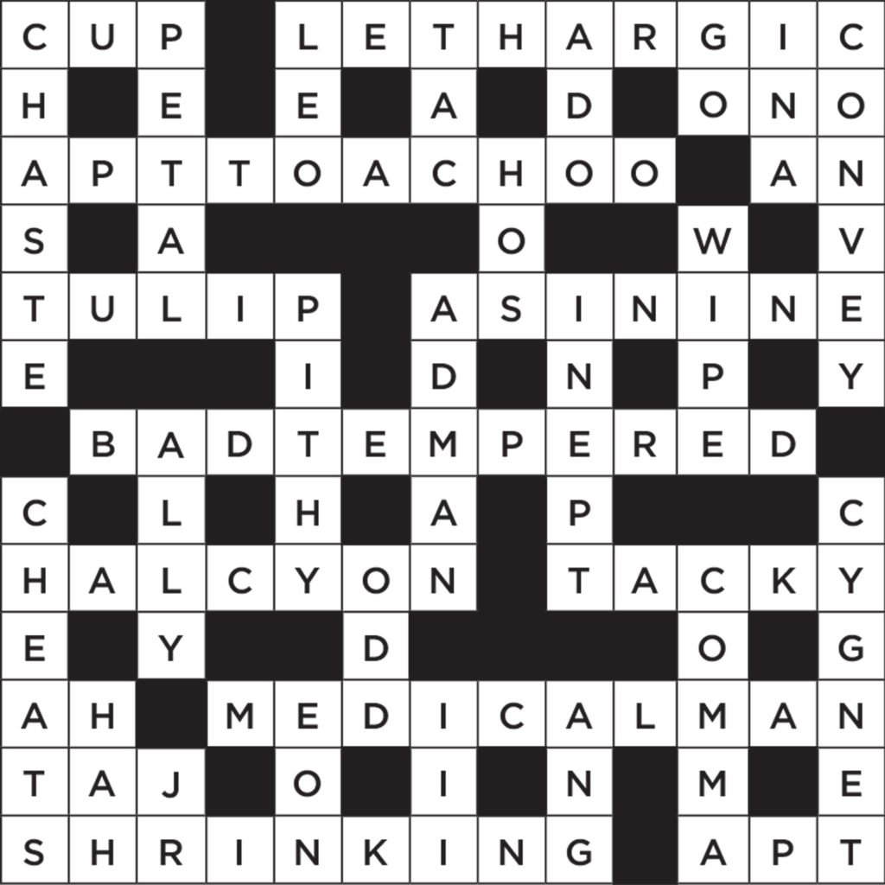
Sample Crossword Puzzle

Slide 13
Find a Location TRIO in a Sentence
Location Trio: (Country, State, City)
Data Structure Proposed:
Create your own data structure using Tree
The Real Task:
Load the data structure at the beginning using the CSV files provided
Find all the possible trio
Group Size:
1 - 3 Students
Important Note:
Direct lookup from files is not allowed
Must use Tree or Graph

Slide 14
Boolean Expression Calculator
Data Structure Proposed:
Find it by your own.
Hint: How mathematical expression is solved?
The Real Task:
Solve a boolean expression which may contain
+ - * / ^ % || () {} [] AND OR NOT NAND NOR XOR XNOR < > <= >= <> ==
Group Size:
1 - 3 Students
Important Note:
Take care of Precedence
Bonus Task: Optimized Solution of Boolean Expression

Slide 15
Stemming and Lemmatization
What is Stemming and Lemmatization?
Research at your own.
Data Structure Proposed:
Find it by your own.
The Real Task:
Find a stemmed word and lemma of a given word
Compare the efficiencies of both of the techniques and discuss their applications in NLP
Group Size:
1 - 2 Students

Slide 16
Basic Regular Expression Matching
Find the matches between Strings and Regular Expression
Constraints:
abc*
*abc
abc*abc
abc..def
Group Size:
1 - 2 Students
Important Note:
Not allowed to use any built in regex solver
* means any length of string, . means a single character
Bonus Task: abc*abc*abc

Slide 17
Document Distancing
To find the distance between given documents
The Real Task:
Determining Similarity between multiple documents
Group Size:
1 - 2 Students
Sample Dataset:
In the Year 2889
The Bobsey Twins on Blueberry Island
Important note:
Solve a real life problem using the discussed technique.

Slide 18
Anagram Solver
Anagram: Word formed by rearranging letters of a word/phrase.
The Real Task:
Given a set words, find all their possible anagrams
Group Size:
2
Advanced Task:
Find anagrams of the given words upto only a certain length.

Slide 19

Not limited to these Projects. Creativity will be Appreciated.

Slide 20

Thank You
“Self-belief and hard work will always earn you success.”

Slide 21
Important Points
If group is doing bonus task then Group Limit ++
The code should be written in C++ language with better readability and necessary comments
Bonus Marks for using any version control (git) for Collaboration among different group members

